Slide 1
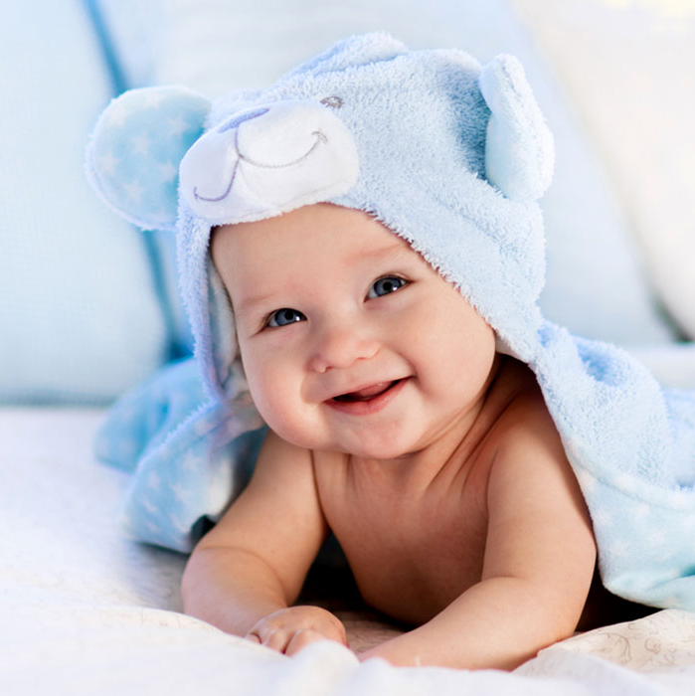
Neonatal Jaundice Detection
-Yash Vardhan Gautam
-Sanchit Namdeo
- Anirudh Singh Bhakar

Slide 2
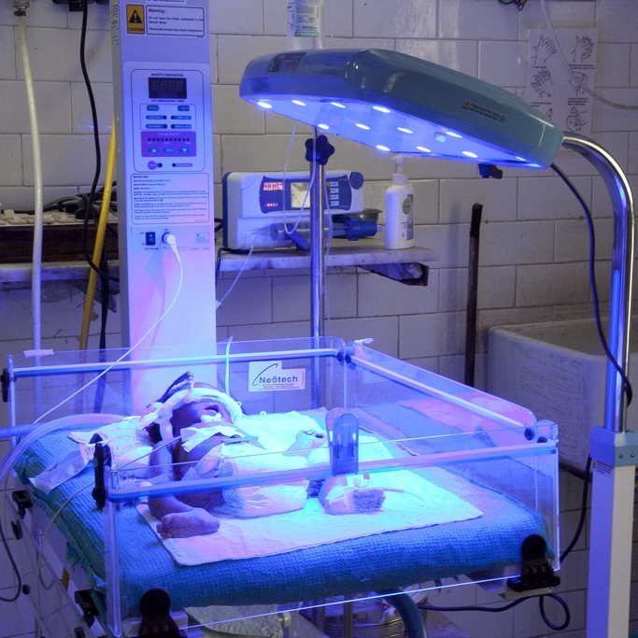
Contents
Problem
Objectives
Conceptual diagram
Methodology
Sensor node and block diagram
Strengths and weakness
Future scope

Slide 3
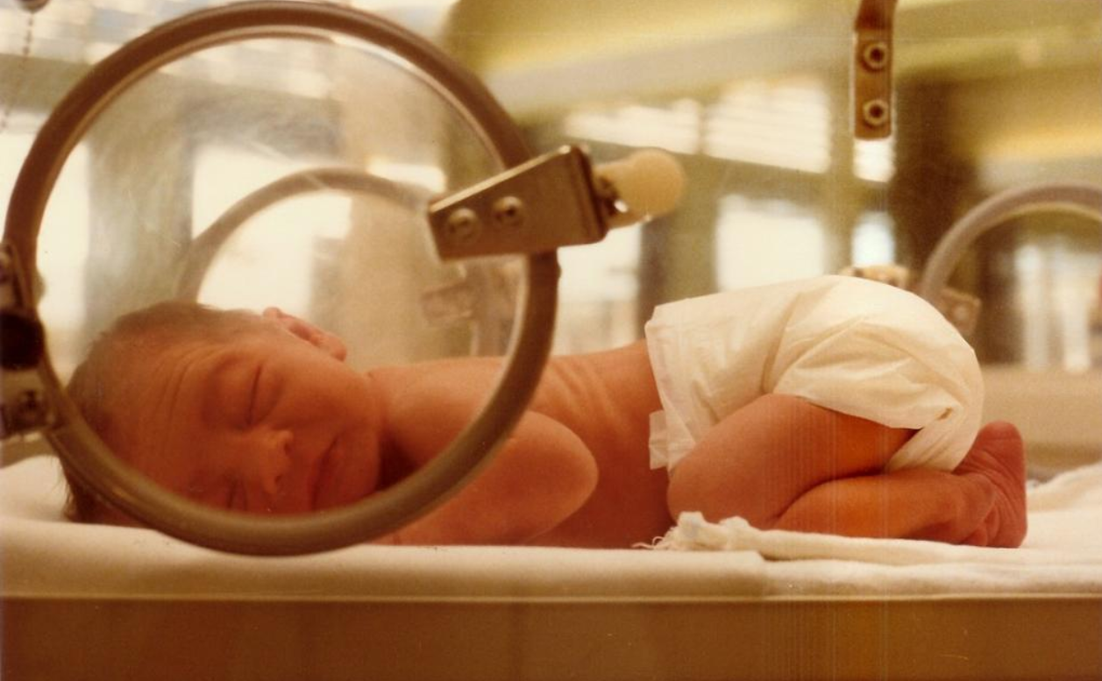
Problem
Jaundice or Hyperbilirubinemia is a prevalent condition that causes yellow discoloration in a new-borns.
The leading cause of jaundice is the blood's high level of bilirubin substance.
In 2010, jaundice took the life of 114,000 infants.
A blood test for Total Serum Bilirubin (TSB) is used to recognize new-borns at high risk of developing bilirubin encephalopathy.
Such a procedure entails the collection of blood samples from patients; thus, it is a painful and stressful procedure and takes time.

Slide 4
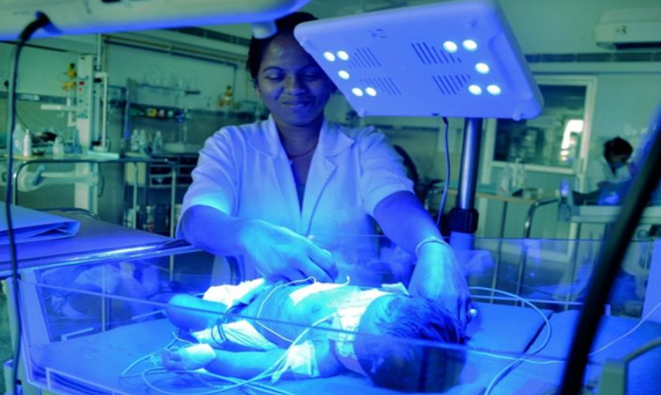
Objectives
To detect the face and skin of the baby using real-time monitoring.
Extract the RGB values from ROI(Region of Interest).
Send the RGB values to the machine learning model and predict the bilirubin values
Sending the bilirubin values over the cloud and plotting them.
Sending the data to the app, so that patients and doctors can access it.

Slide 5
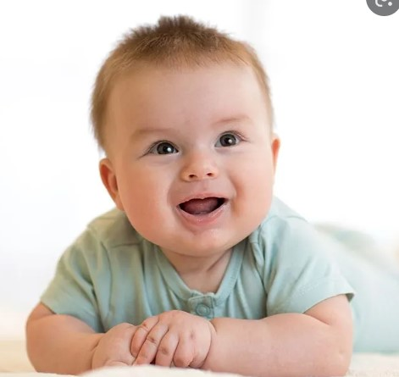
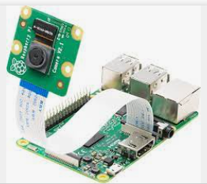
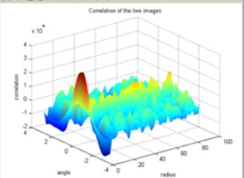

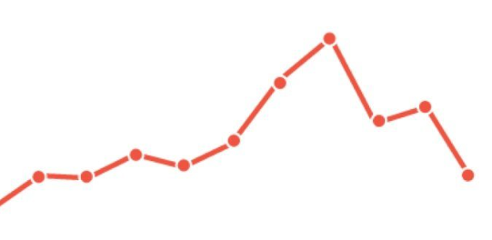
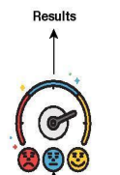
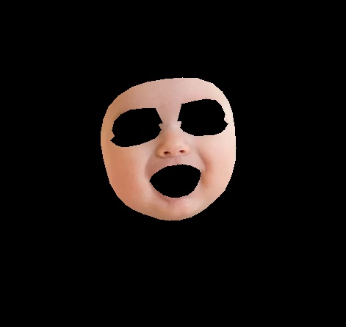
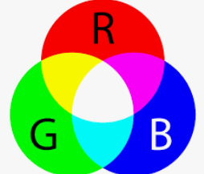
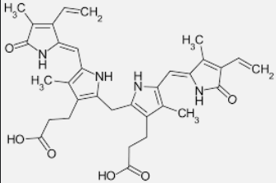
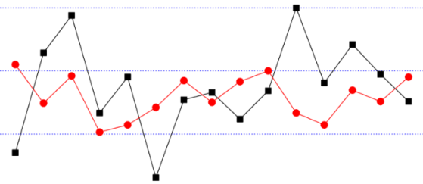
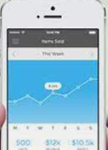
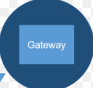
Neonatal Jaundice Detection
ML Working
Model
The doctor and parent can access the graph of their patient and child respectively and check the Bilirubin value
Raspberry pi captures the image of baby at constant interval of time
Plotting of Bilirubin value vs time graph on cloud
BABY
Analysis of the captured image by the ML model of the trained dataset
Baby Image
Extracting only the skin area from the image.
Now, taking the average of the RGB value of the image
From the RGB value taking out the Bilirubin value with the help of trained dataset
Passing the Bilirubin data from the raspberry pi to the cloud through Gateway
Displaying the whole graph on an web application.
Plotting the graph of Bilirubin value on cloud and checking it from threshold value.

Slide 6
Sensor Node Diagram
Battery 12V
Cloud
Web Camera
Raspberry Pi 3
Micro- Processor
Displaying Bilirubin value
Plotting of Graph

Slide 7
Methodology
Capturing image of baby
Cropping of image and Taking Useful part of Image
RGB value
Model used
Predicting the Bilirubin value

Slide 8
Capturing image of baby
The first step is to capture the image of the baby.
So, we have used Raspberry Pi as our main instrument.
In Raspberry Pi, we have installed a camera which will take the image.
The image will be taken automatically and at regular interval of time like 30 minutes

Slide 9
Cropping of Image
Now, as the image is been captured, we have to crop out the unnecessary useless part.
So, in our case, the useful part is only skin area.
So, we have cropped the unnecessary part of the baby.
All the unnecessary part is darkened like eyes, eyebrows, mouth, etc..

Slide 10
RGB Values
So, the ROI has been detected and the other unnecessary part has been darken.
Now, we have taken out the RGB value of the whole image and averaged it.
Since, the RGB value of darken area is zero, therefore the darken area (useless area) will have no effect in the RGB value.

Slide 11
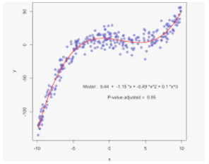
Model
Now, to train our model, we have used a dataset of 24 images and taken out their average RGB values and their Bilirubin values were already provided.
Now, we have plotted the graph of the RGB value vs their Bilirubin value.
For predicting the value, we have used Support Vector Machine Algorithm , which has proven to be best as of now with an accuracy of almost 88 percent.

Slide 12
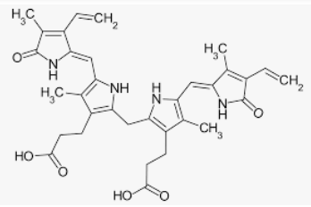
Predicting the Bilirubin value
Now, with the help of the Support Vector Machine of the training dataset, we have taken out the Bilirubin value of image taken.
The Bilirubin value is then stored in a CSV file and compared with the threshold value.

Slide 13
Block Diagram
Image Processing Technique
Real-time
Dataset
ROI Detection
Skin color analysis
RGB Frame
B channel value is estimated from RGB.
The estimated value is compared with a threshold and declaration is made.
The estimated Bilirubin value is then displayed on the cloud and graph is plotted.

Slide 14
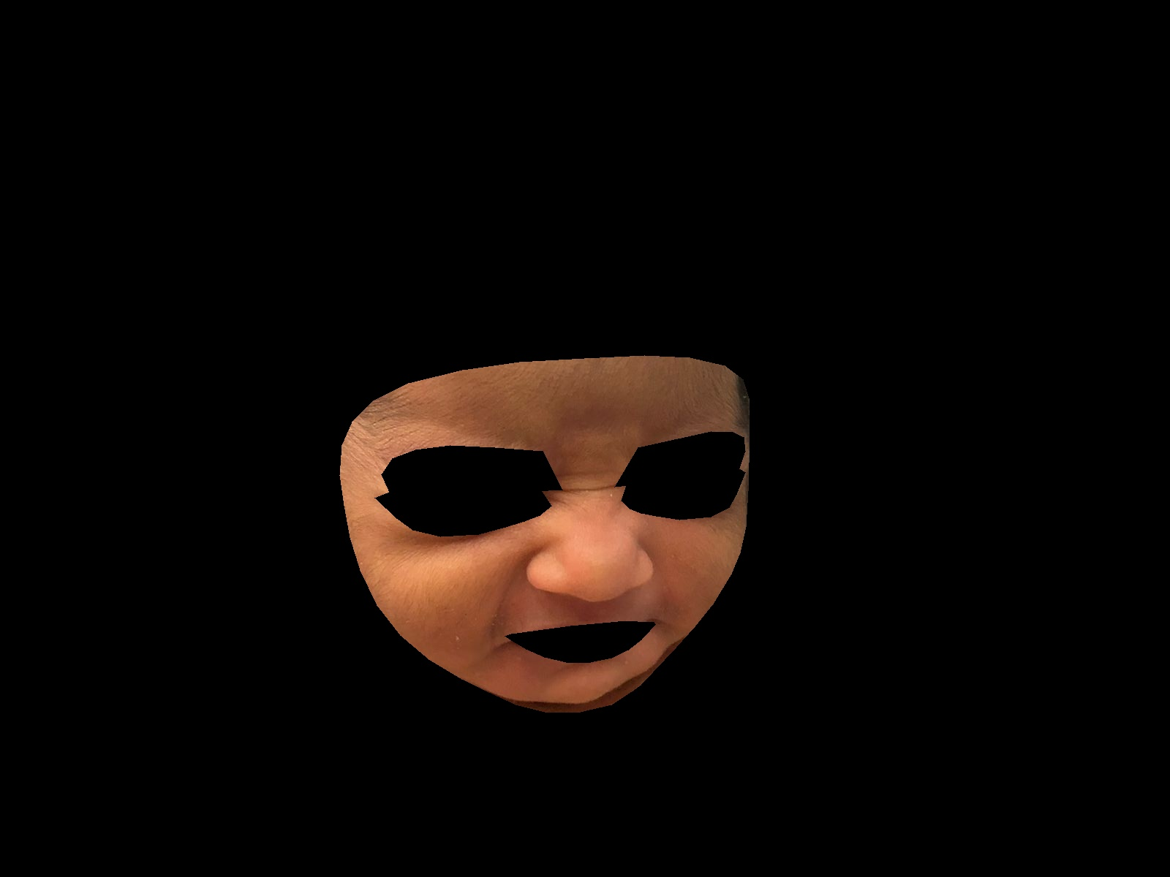
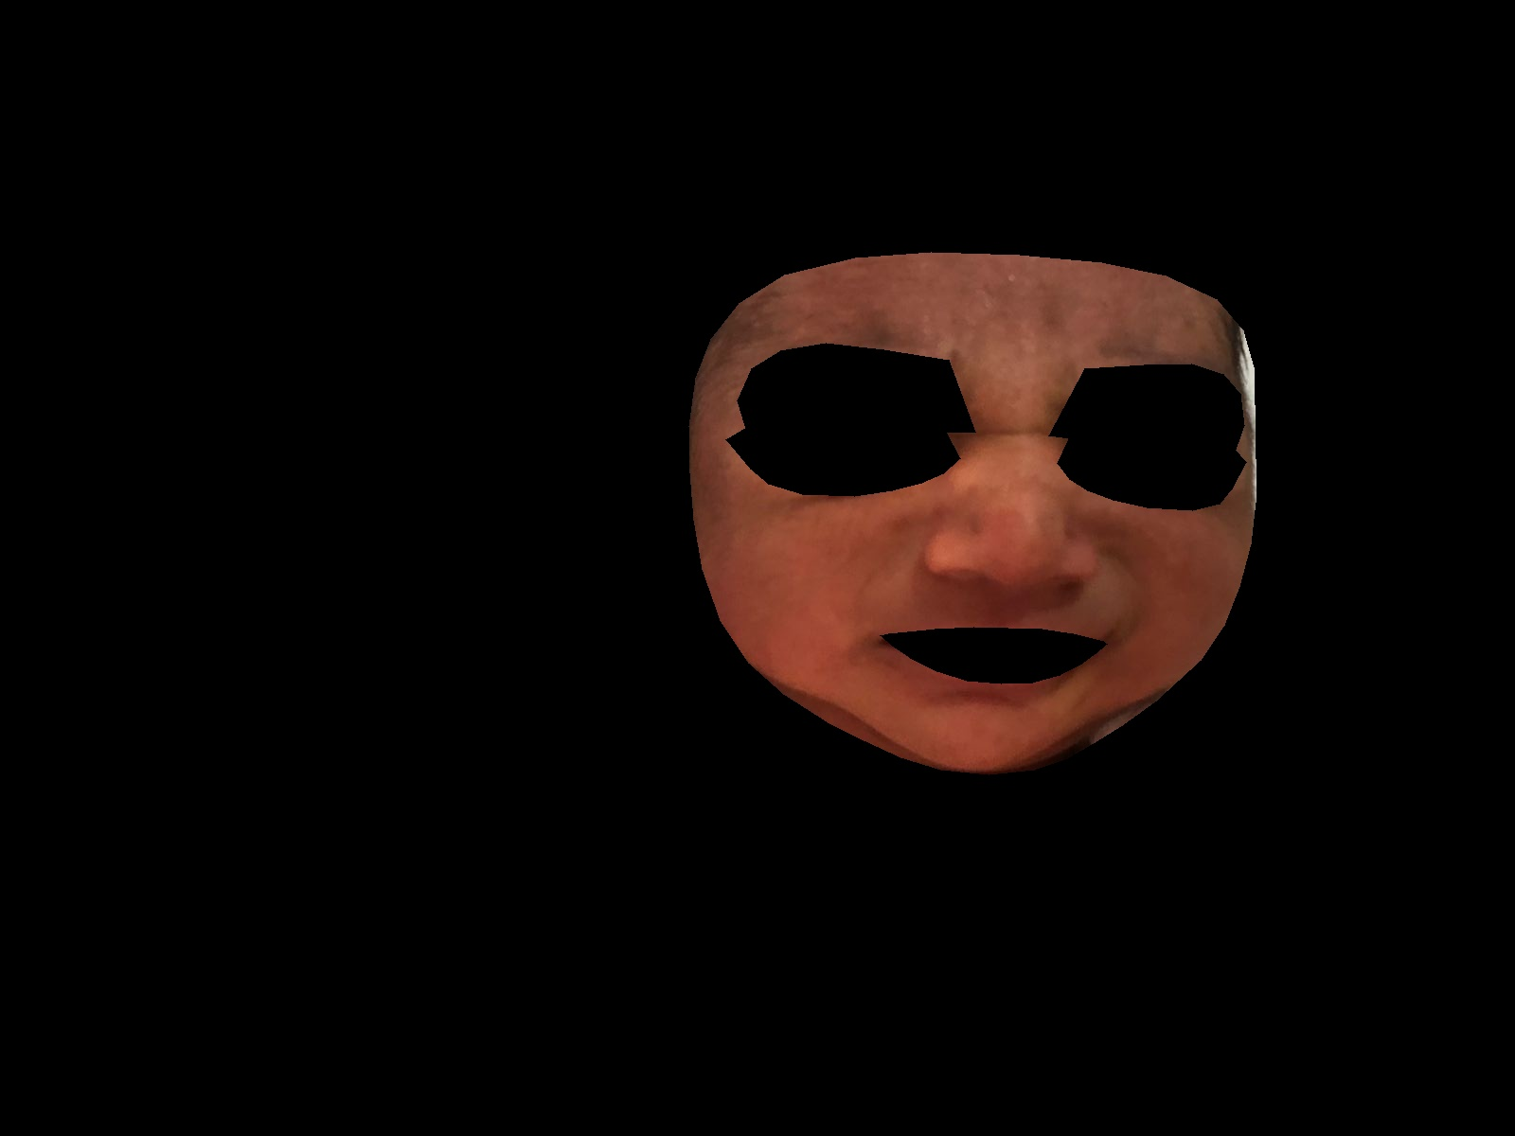
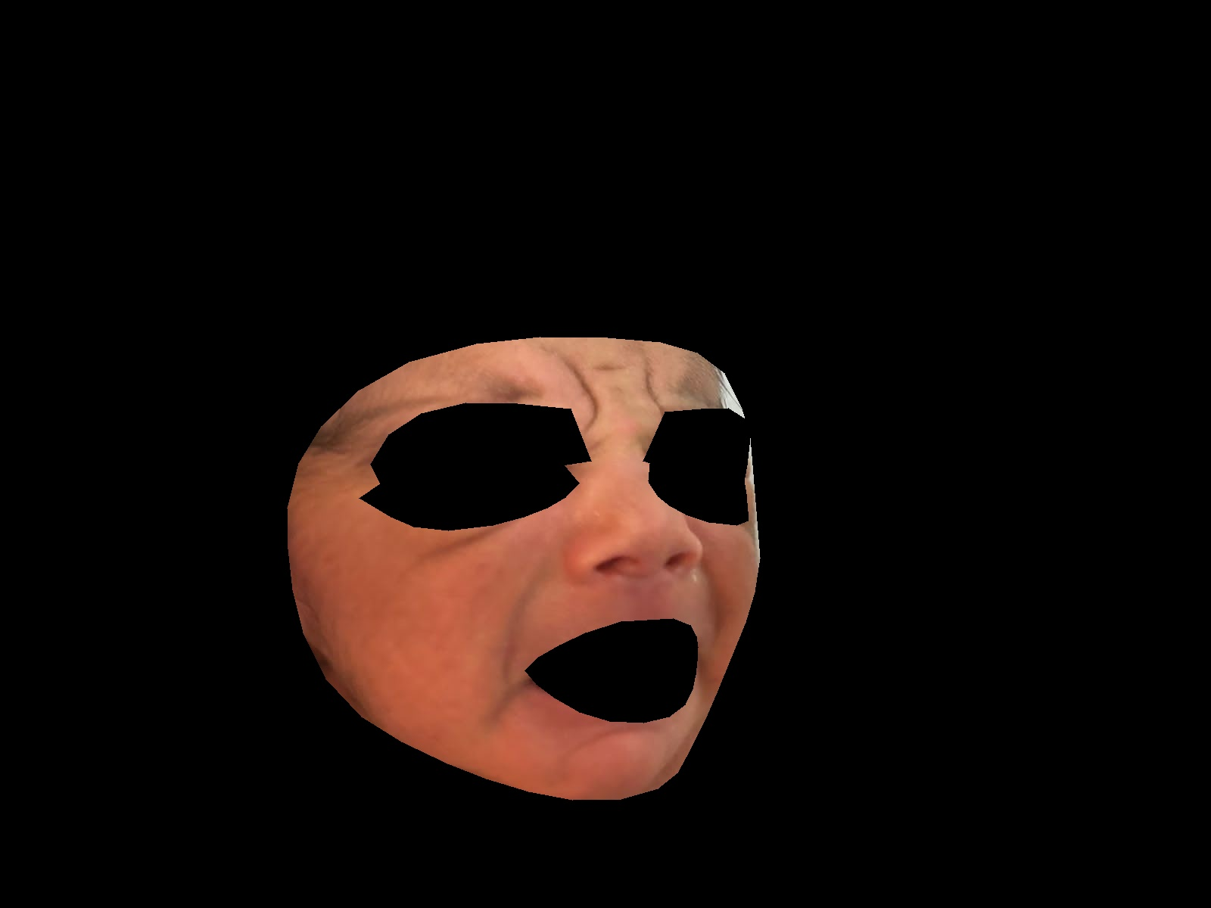
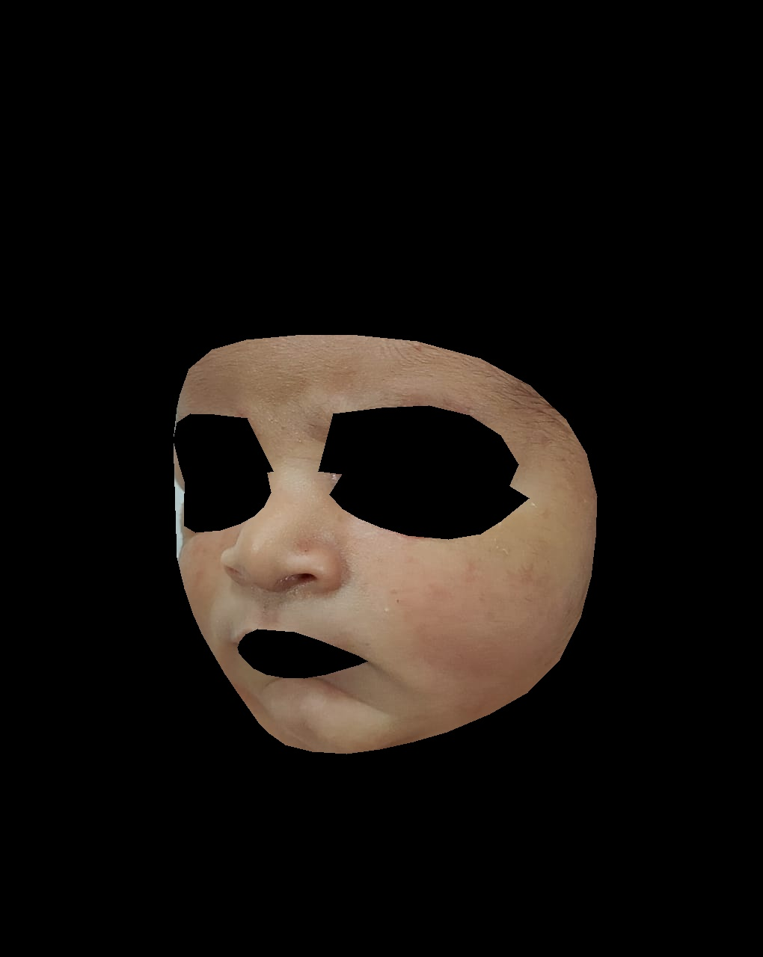
RESULTS
Image Captured | ROI Extracted | RGB Value Calculated | Predicted Bilrubin Value | True Bilrubin Value | Accuracy (in Percent) | Model Accuracy (In Percent)
Can not show (due to privacy concerns) |  | 142,88,75 | 8.5092 | 8.8 | 96.52 | 87.72
Can not show (due to privacy concerns) |  | 226,168,147 | 6.1922 | 5.5 | 87.41
Can not show (due to privacy concerns) |  | 193,157,145 | 5.9807 | 6.2 | 96.40
Can not show (due to privacy concerns) |  | 152,121,97 | 7.5207 | 8.2 | 90.2

Slide 15
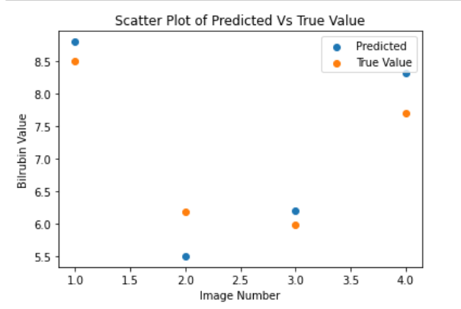
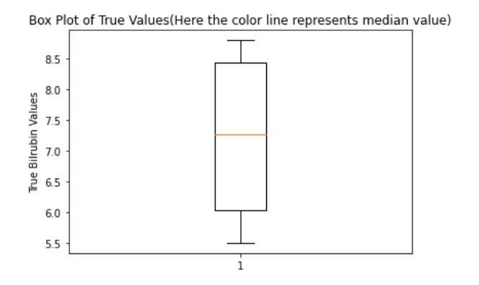
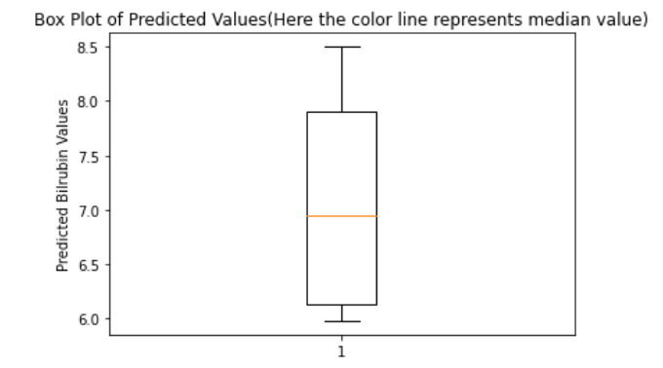
Visualizing The results
Note- Above graphs shows the variation and difference between True values and predicted values. It gives us the idea of accuracy of our model

Slide 16
Strength
Weakness
This project aims to detect jaundice more efficiently using the image sensing method, and also this method is quick as compared to the traditional way.
It is cost-effective.
It is not as accurate as of the Total Serum Bilirubin (TSB) test.
It depends on the baby’s skin color; the result may vary.

Slide 17
Possible enhancements
Extract the local region based on the feature points obtained from the eyes and mouth and by adjusting the camera setting of the experiment.
To make the machine learning model more accurate by including skin data from the various region of the world

